Slide 1
IMAGES,LINKS & LISTS

Slide 2
IMAGES
The HTML <img> tag is used to embed an image in a web page.
Images are not technically inserted into a web page; images are linked to web pages.
The <img> tag is empty, it contains attributes only, and does not have a closing tag.
The <img> tag has two required attributes:
src - Specifies the path to the image
alt - Specifies an alternate text for the image

Slide 3
Image Size - Width and Height
We can use the width and height attributes:
The width and height attributes always define the width and height of the image in pixels.
<img src="img_girl.jpg" alt="Girl in a jacket" width="500" height="600">

Slide 4
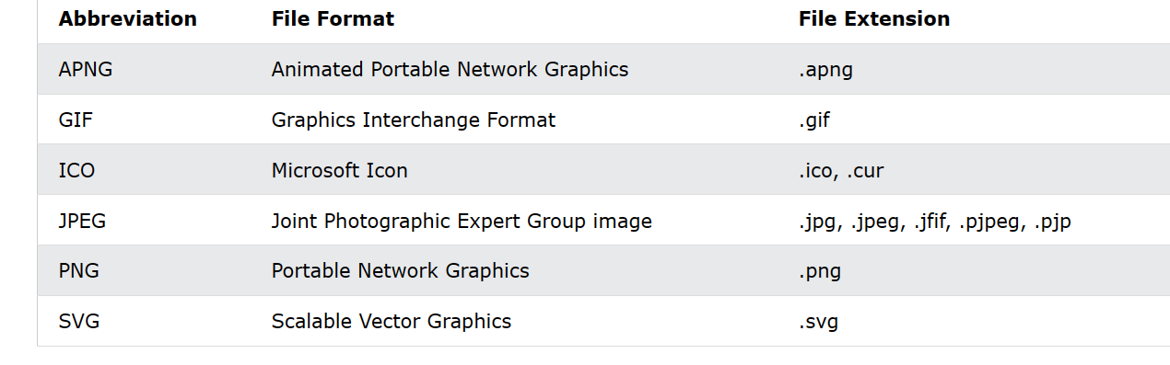
Common Image Format

Slide 5
LINKS
Links are found in nearly all web pages. Links allow users to click their way from page to page.
HTML links are hyperlinks.
The <a> tag defines a hyperlink
Syntax :
<a href="url">link text</a>

Slide 6
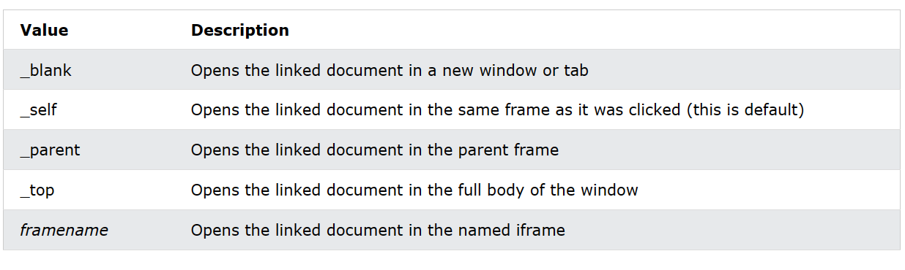
Target Attribute
The target attribute specifies where to open the linked document.
Syntax
<a target="_blank|_self|_parent|_top|framename">

Slide 7
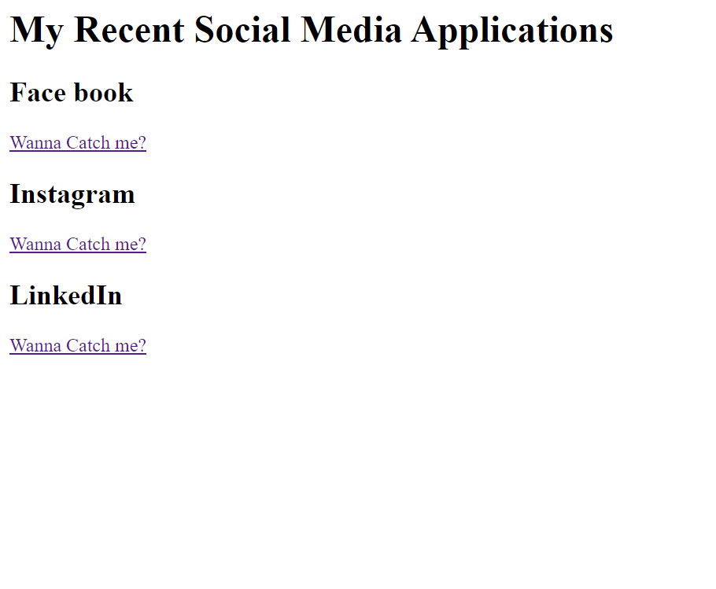
TASK 1

Slide 8
Links with Images
<a href="default.asp"> <img src=“sun.png" alt=“sunimage" style="width:42px;height:42px;"> </a>
An unvisited link is underlined and blue
A visited link is underlined and purple
An active link is underlined and red

Slide 9
LIST
HTML Lists are used to specify lists of information.
All lists may contain one or more list elements.
It allow web developers to group a set of related items in lists.
Each list item starts with the <li> tag.

Slide 10
TYPES OF LIST
There are three different types of HTML lists:
Ordered List or Numbered List (ol)
Unordered List or Bulleted List (ul)
Description List or Definition List (dl)

Slide 11
1. ORDERED LIST
In the ordered HTML lists, all the list items are marked with numbers by default.
It is known as numbered list also.
The ordered list starts with <ol> tag and the list items start with <li> tag.
List can be reversed also available <ol reversed>
Eg: <ol >
<li>Coffee</li>
<li>Tea</li>
<li>Milk</li>
</ol>

Slide 12
ORDERED LIST
There can be different types of numbered list:
Numeric Number (1, 2, 3)
Capital Roman Number (I II III)
Small Romal Number (i ii iii)
Capital Alphabet (A B C)
Small Alphabet (a b c)

Slide 13
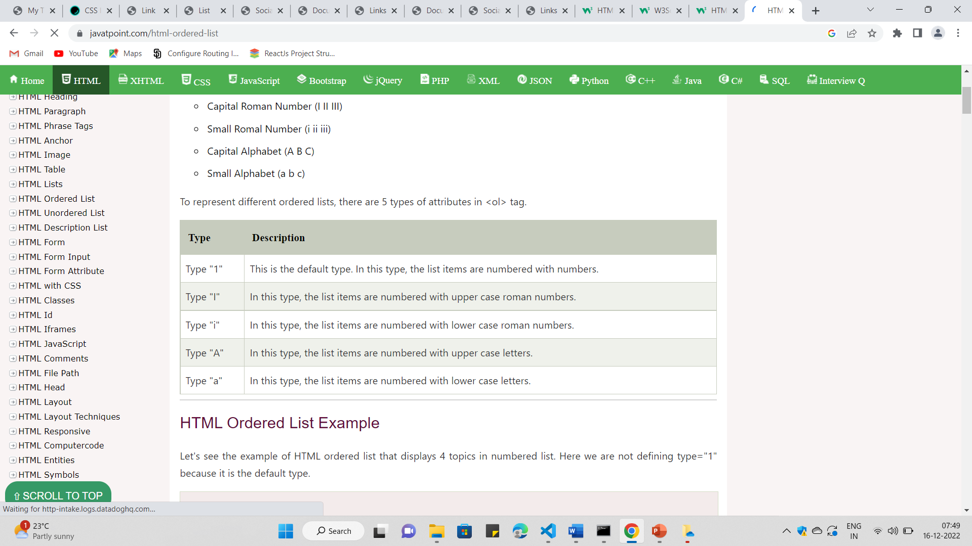
DIFFERENT TYPES OF ODERES

Slide 14
2.UNORDERD LIST
An unordered list starts with the <ul> tag.
The list items will be marked with bullets (small black circles) by default
Eg:
<h1>I love these drinks...!</h1>
<ul>
<li>Coffee</li>
<li>Tea</li>
<li>Milk</li>
</ul>

Slide 15
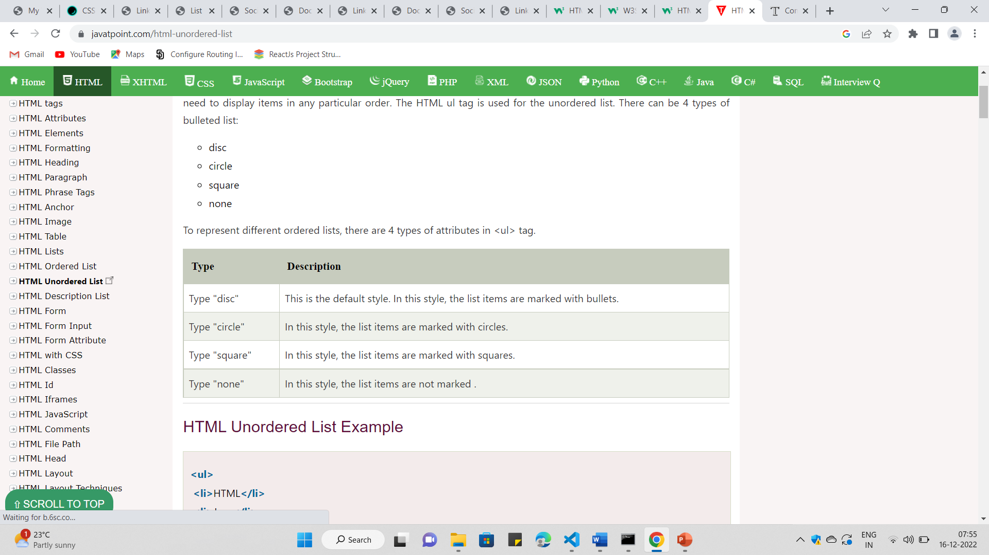
TYPES OF UNODERES LIST

Slide 16
3.DEFINITION LIST/DESCRIPTION LIST
A description list is a list of terms, with a description of each term.
The <dl> tag defines the description list
The <dt> tag defines the term (name)
The <dd> tag describes each term

Slide 17
<dl>
<dt>Coffee</dt>
<dd>- black hot drink</dd>
<dt>Milk</dt>
<dd>- white cold drink</dd>
</dl>

Slide 18
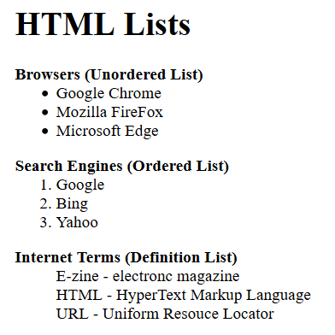
TASK 2

Slide 19
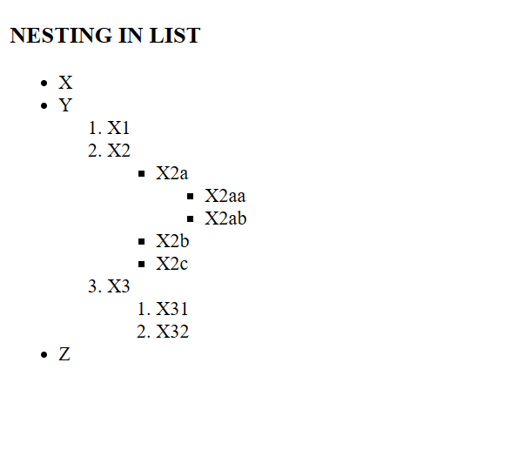

Slide 20
Thank You

